Slide 1














Promoting Physical Activity and Nutrition Awareness in Middle School Youth Through the Design of Activities Using Geospatial Technologies
By Chelsea Page
The University of Arizona
Department of Nutritional Sciences
April 21st, 2012

Slide 2
Thank You!
Nobuko (Kay) Hongu, PhD – Mentor: Nutritional Sciences Extension Specialist (UA)
Barron Orr, Ph.D. – co-Mentor: Extension Specialist, Associate Director, UA/NASA Space Grant Program
Martha Mosqueda – Graduate Student, Nutritional Sciences (UA)

Slide 3
Overview
Objective
i-Challenge! Program Development
  Design and Purpose
  GPS Integration
  Previous Activities
  New Activity: Tag
Interpretation
Future Research and Application

Slide 4
Objective & Goal
Develop a new activity utilizing geospatial and mobile technologies that will encourage nutrition awareness and physical activity (NPA) in vulnerable youth.
After designing the new activity, TAG, implement the activity in an appropriate setting, collect and analyze data to determine it’s success, asses future potential, and present the experience and potential use.
Notes:
*Most modifiable aspects
*Reduce obesity risk
*All populations
*Early intervention → Youth

Slide 5
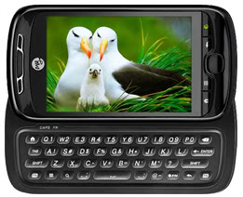
GPS Technologies
GPS = Global Positioning System
Increased availability and usage of mobile technologies
Combination of mobile and geospatial technology
Applications developed by the Stealth Health team
Notes:
GPS Technology was used in this experiment due to the fact that mobile technologies have become increasingly available to all populations and are increasingly being used for a range of tasks. The phones used in this experiment were the T-mobile my touch 3g slide which were loaded with applications developed by the University of Arizona’s Stealth Health Team which combined the mobility of a cell phone with geospatial technology.

Slide 6
i-Challenge!
8-week program
Population: Vulnerable youth ages 11-14
Two middle schools
  Control (w/o mobile GPS technology): Hohokam Middle school, Coolidge, AZ
  Experimental (w/ mobile GPS technology): Sequoia Pathway Academy, Maricopa, AZ
Four team-based activities
Notes:
Dr. Hongu’s team developed an 8 week program, i-Challenge, that was implemented in two middle schools involving youth ages 11-14. This program monitored NPA through pre and post interventions. Throughout the 8 weeks we introduced four team based activities, three of which had been developed and used previously in other programs. The fourth activity was designed specifically for this program. The control group represented traditional NPA education while the experimental group received smart phones that were GPS capable and equipped with applications developed by the stealth health team. For the sake of time, I am going to focus on the experimental group for this presentation.

Slide 7
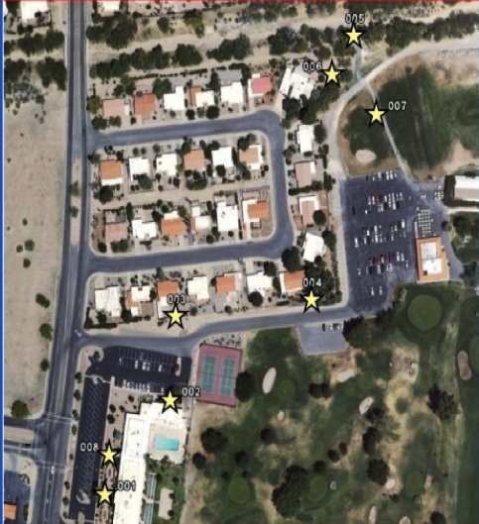
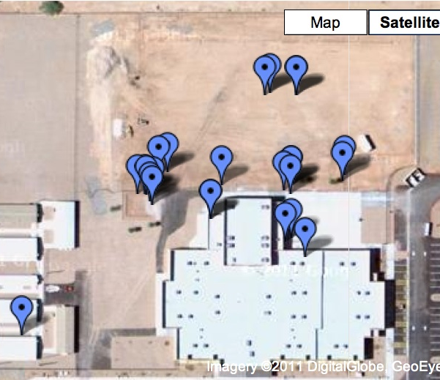
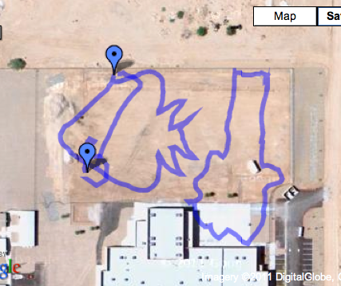
Four Activities
Treasure Hunt
Mapping
Earth Drawing
TAG!
Notes:
(Pictures for treasure hunt?)

Slide 8
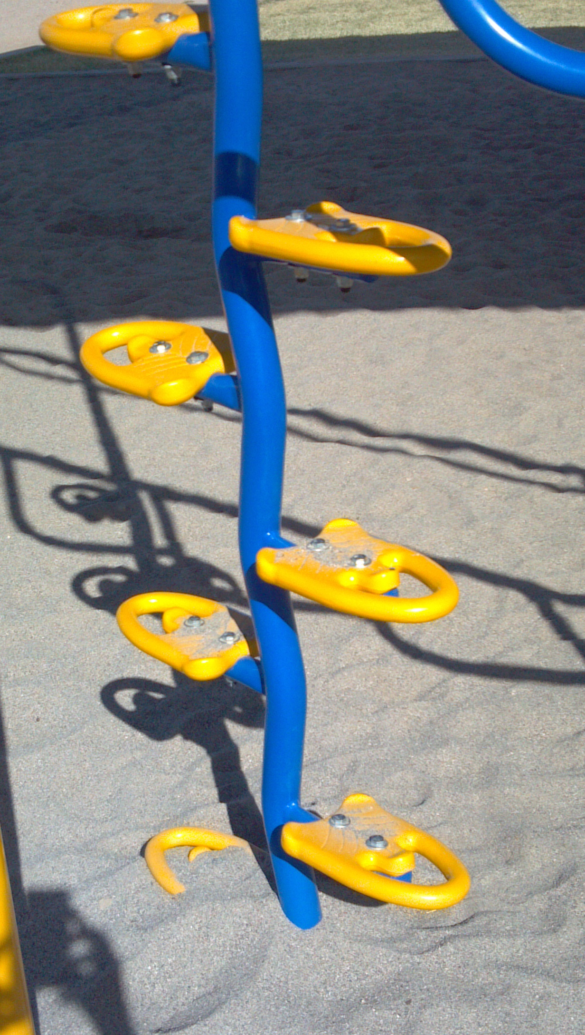
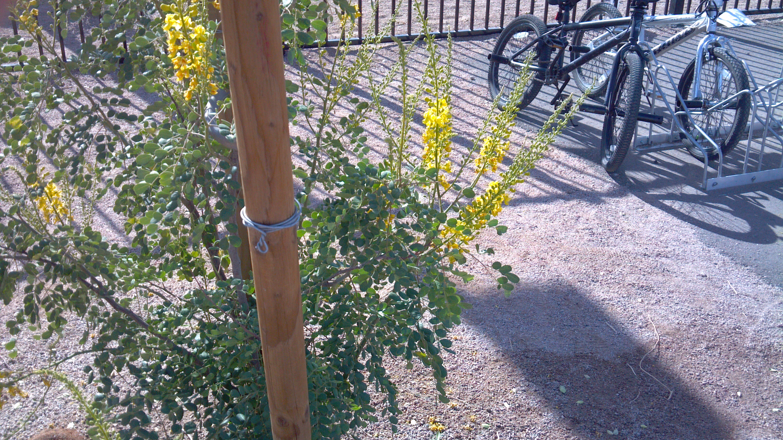
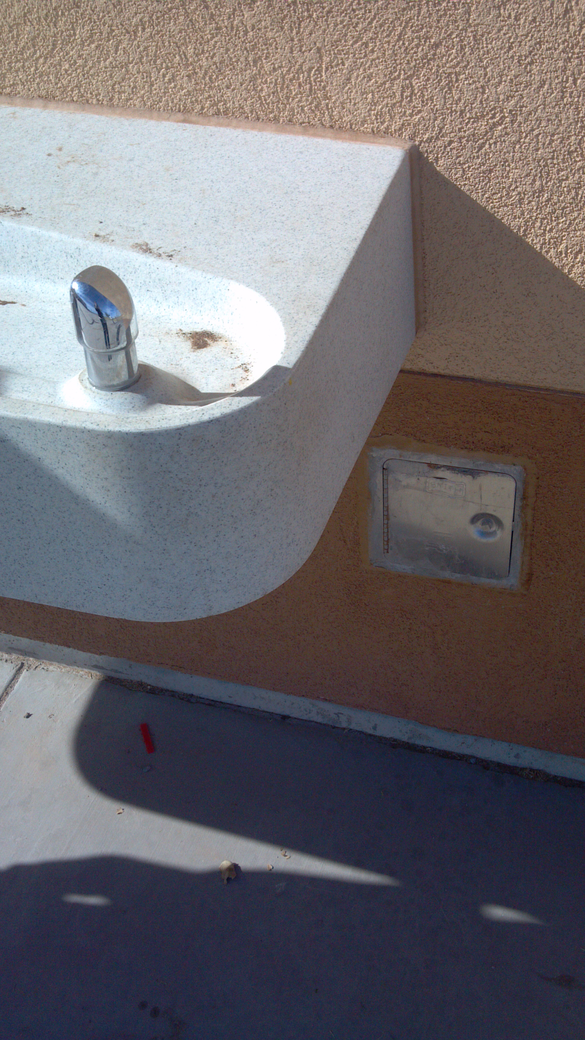
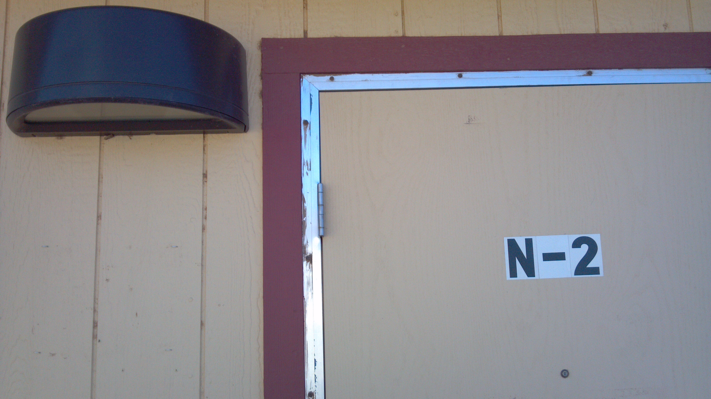

TAG Activity
Kids between the ages of 6 and 14 eat fast food 157,000,000 times every month in the U.S. How much fast food do you eat? Many people eat the entire amount of calories they need for one day in just one meal at a fast food restaurant! Decrease your portions to increase your health!
Based on a relay race concept where photos and NPA facts represent the baton
Notes:
Photos, as shown here, were given to the first person in the relay. When the start whistle was blown, they were off to find the location where the photo was taken. Once they found the location, they were to mark it using the GeoSnap application to show they had actually been to the location, and pick up the photo with the next location to return to the next teammate as a baton. Attached to each photo was an NPA fact as shown here.

Slide 9
TAG: Design on the Google map
Notes:
Here is a basic example of how this activity worked. While attempting to determine what activities middle school youth enjoy engaging in, I thought of how much I enjoyed playing tag and doing relay races when I was a child. Originally the activity was more of a traditional tag concept and morphed into more of a relay race where the locations are “tagged” with photos.

Slide 10
TAG: Introduced and implemented!
30 youth
During normal 50 minute PE class in the afternoon
Divided into 4 teams at beginning of i-Challenge!: Blue, Yellow, Green, Red
Pedometer for activity
~30 minutes
Post-Challenge Questionnaire

Slide 11
Post-Challenge Questionnaire

Slide 12
Results
Median steps = 543 steps, ~0.125 miles
~5 minutes of walking/student
0.125 miles/5 minutes → moderate activity

Slide 13
Interpretation
The activity had positive feedback from the participants
Based on what I observed, there is potential for this activity to successfully encourage NPA in vulnerable youth.

Slide 14
The Future
This activity may be used in future studies involving mobile phones with GPS features and in collaboration with other activities to encourage NPA in a variety of populations beyond middle school youth.

Slide 15
Acknowledgements
Pinal County Cooperative Extension
Office of Arid Land Studies
Department of Nutritional Sciences
Walk Across Arizona
Sequoia Pathway Academy
Hohokam Middle School
Akshen.org and Recaller software development was supported by a USDA-NIFA-NRI grant #2009-55215-05187
Thank you!

Slide 16
